Slide 1
Python Data Analysis Project
Alexandra Fuks

Slide 2
The problem:
I analyzed a telecommunications company's customer dataset to predict churn by examining behavior patterns and usage statistics.
I identified which customers have churned and which have not, focusing on attributes such as service interactions and demographics.
This analysis reveals insights that drive strategies for improving customer retention and optimizing service offerings.

Slide 3
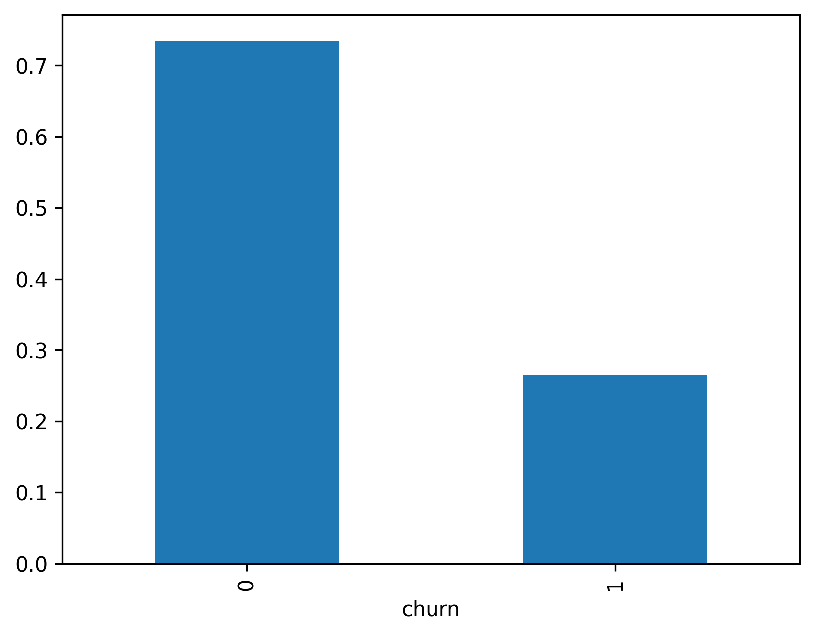
Data Description:
There are 7043 customers in dataset, 1869 of them churned the company ~ 26.54%.
There are 20 features in the dataset.
I split the dataset for 5635 rows to train set and 1408 rows to test set.
There are no missing values in the dataset.

Slide 4
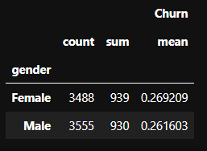
Some Aspects of the data:
Gender Distribution:
Female – 49.5%
Male – 50.5%
There are no effect of gender on churning

Slide 5
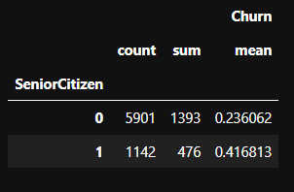
Some Aspects of the data:
Senior Distribution:
~16.2% of customers are seniors
1142 of them churned
41.7% of churning customers are seniors

Slide 6
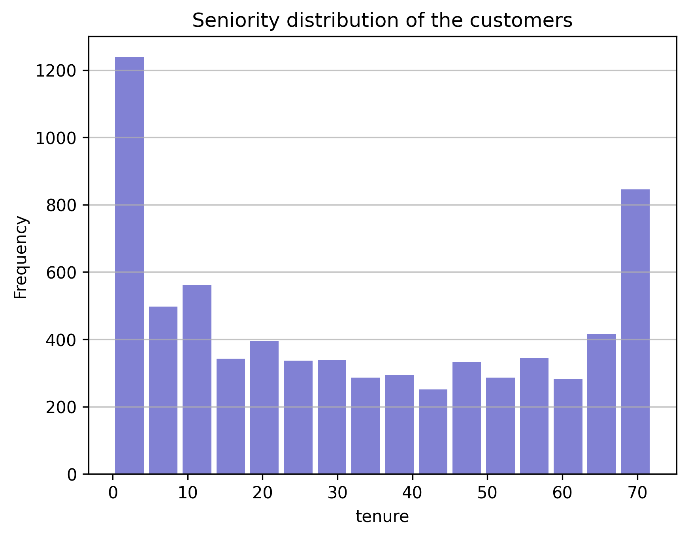
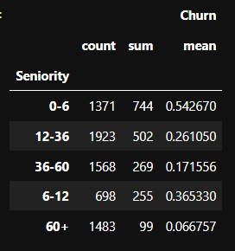
Some Aspects of the data:
Most of churnings happened in first half year ~54.2%.

Slide 7
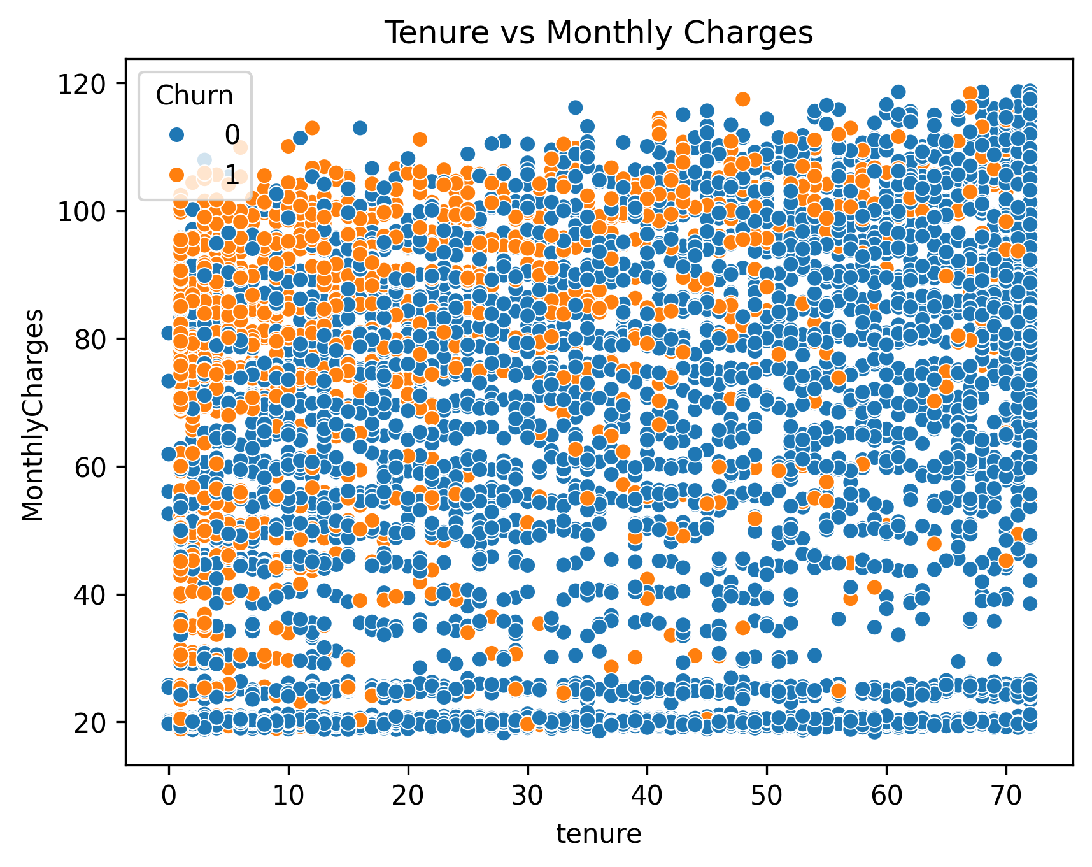
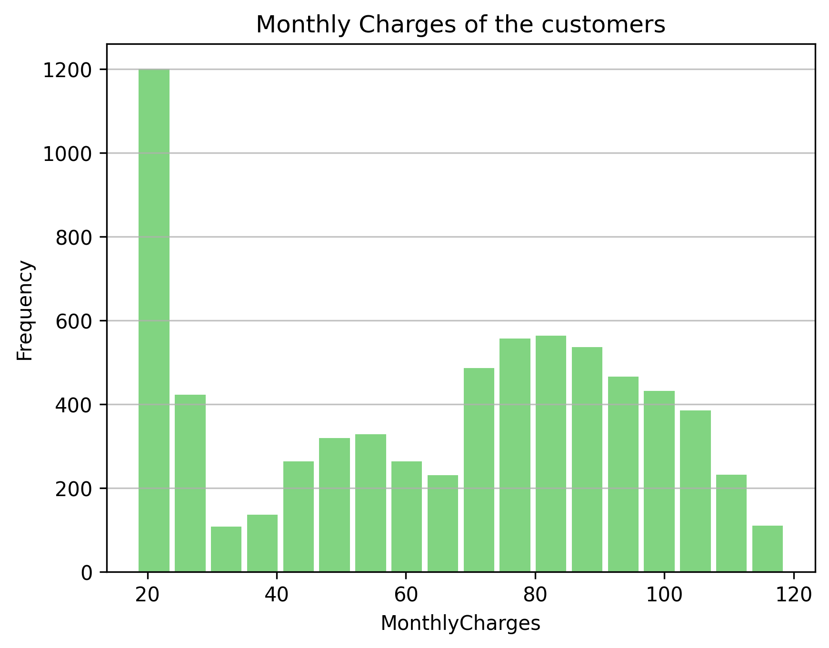
Some Aspects of the data:

Slide 8
Some Aspects of the data:
Strong correlation between churn and:
Tenure
Contract Month-to-month
Internet fiber optic service
Monthly charges

Slide 9
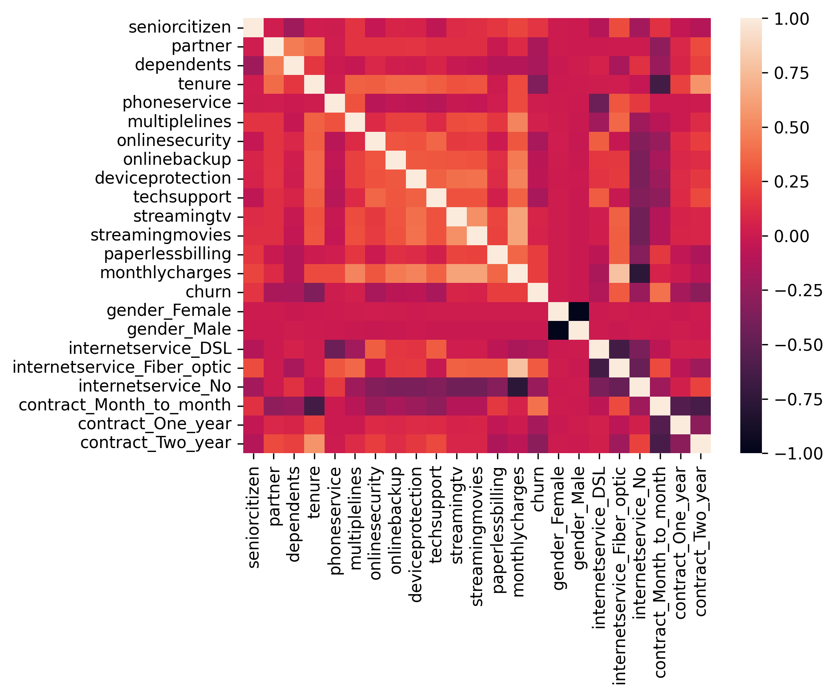
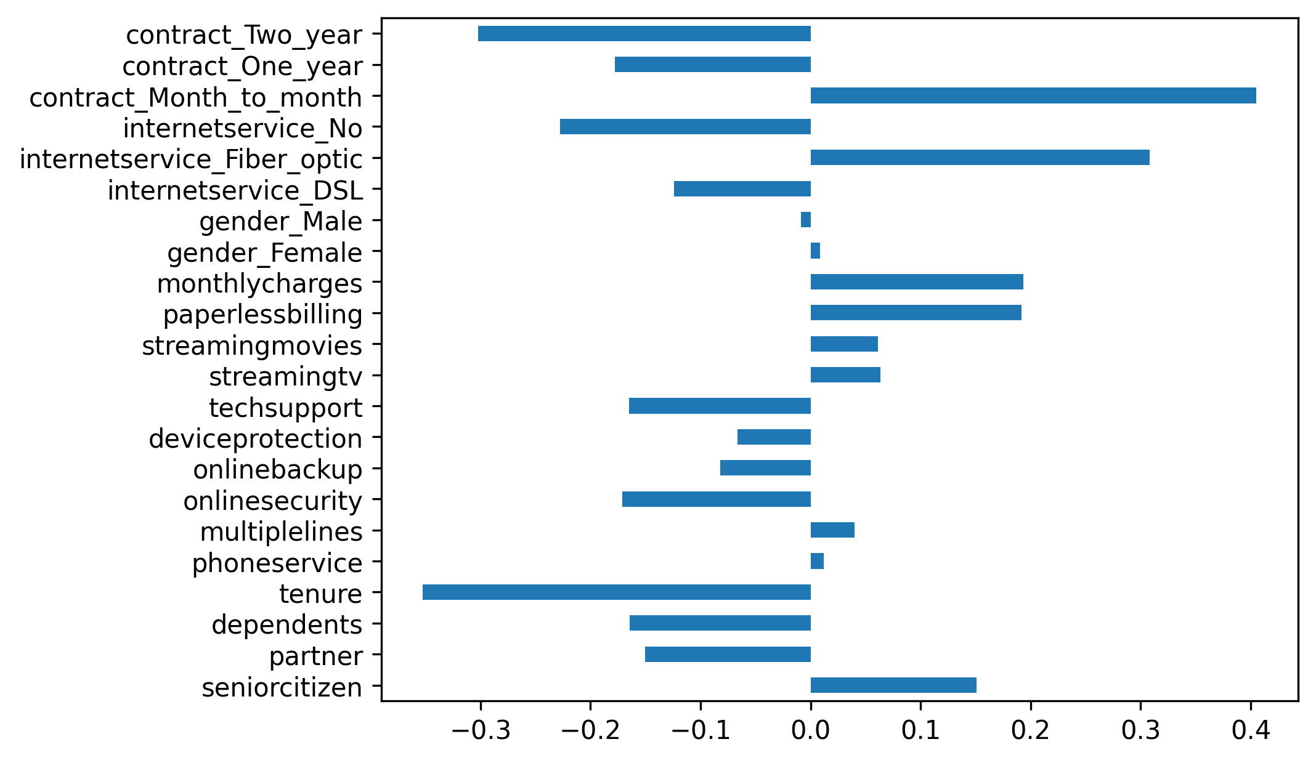
Some Aspects of the data:

Slide 10
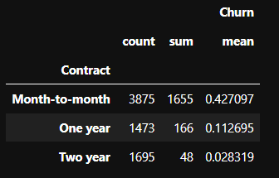
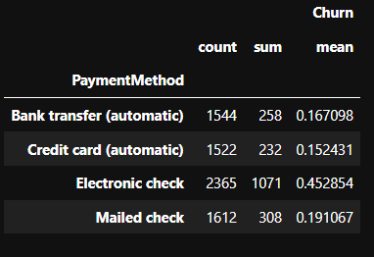
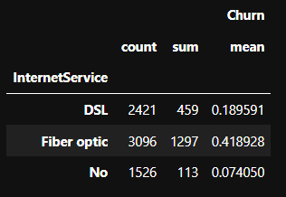
Some Aspects of the data:
42% of churned had month-to-month contract, 45% used electronic payment method, ~42% had fiber optic internet service.

Slide 11
Data engineering:
I remove 3 features: CustomerID, Totalcharges and Paymentmethod
I add only new “id” column range from 1 to 7043.
There are no missing values in the dataset.

Slide 12
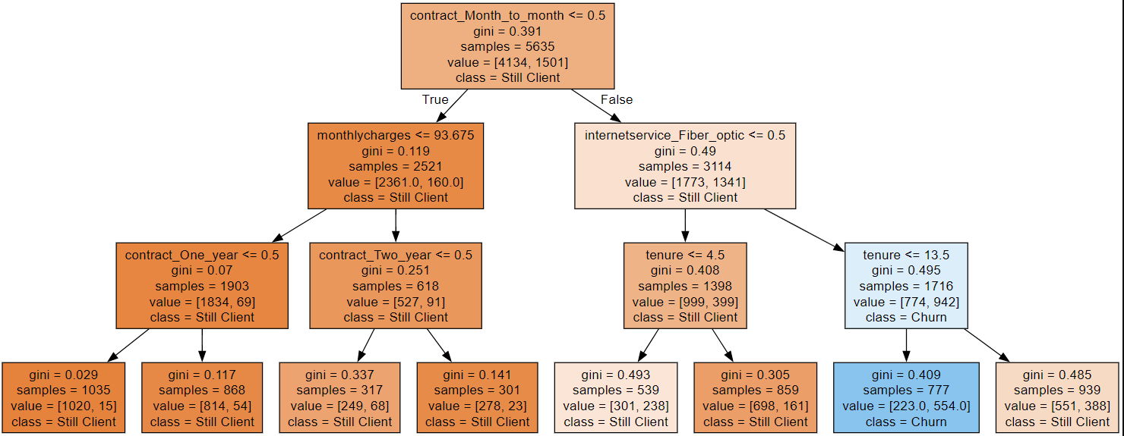
ML Algorithms: Decision Tree

Slide 13
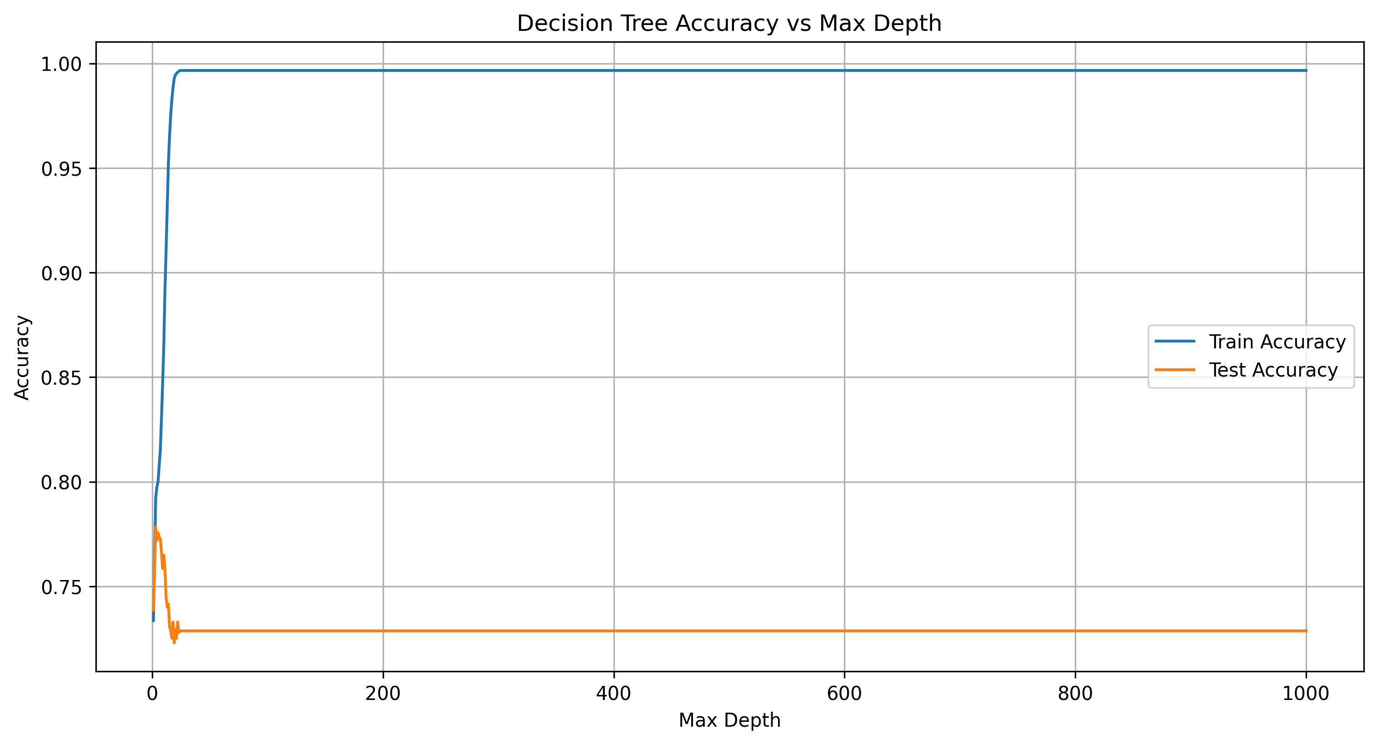
ML Algorithms: Decision Tree
The best accuracy with 3 depth value 77.84%.
It better then benchmark of 73.9%.

Slide 14
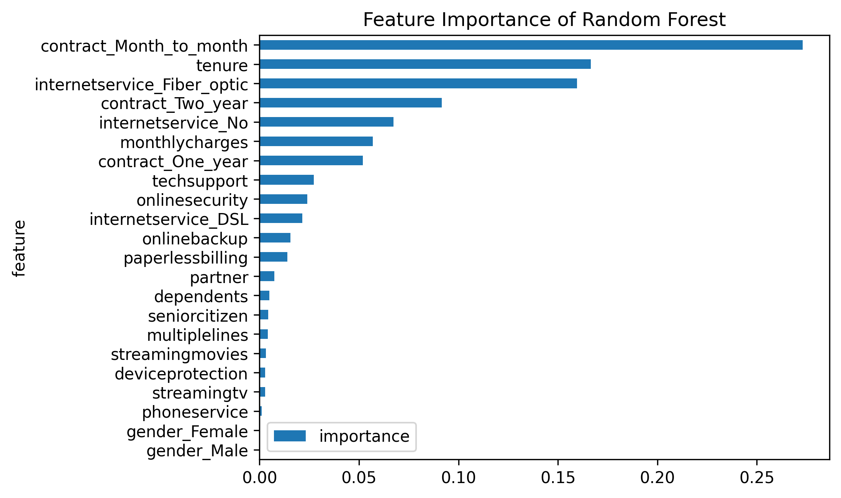
ML Algorithms: Random Forest

Slide 15
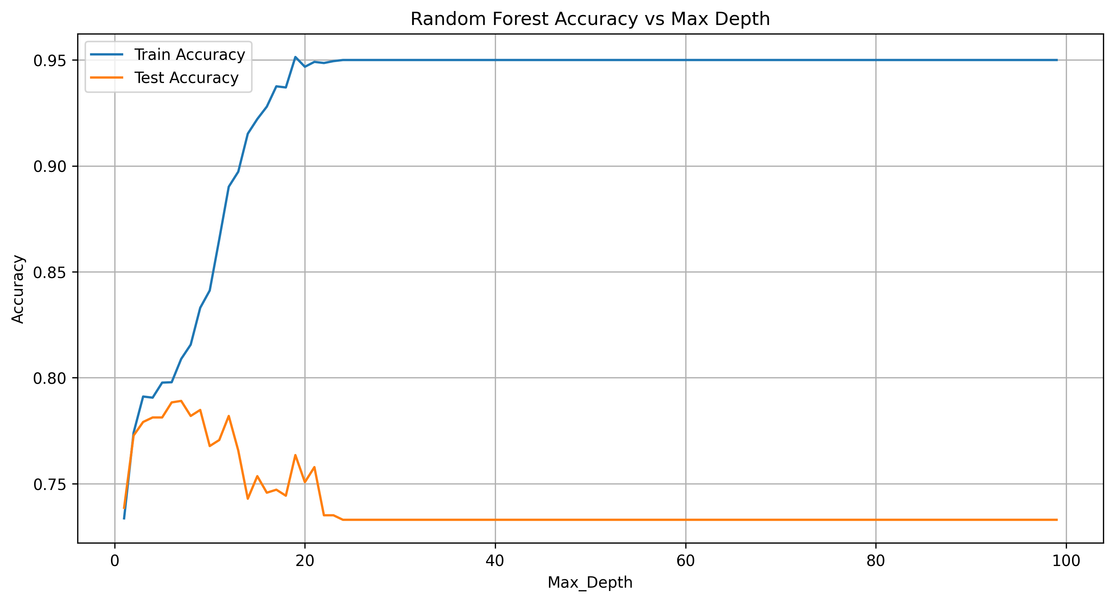
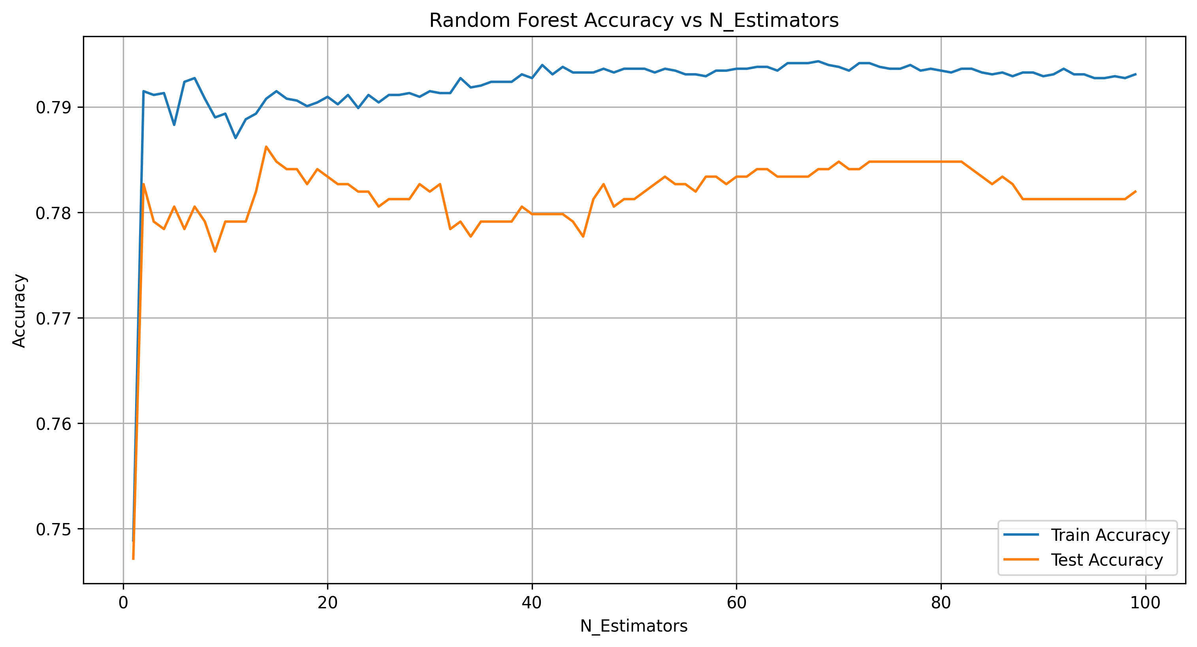
ML Algorithms: Random Forest
The best accuracy with 3 n_estimators and 7 max_depth values 78.9 %.
It better then benchmark of 73.9%.

Slide 16
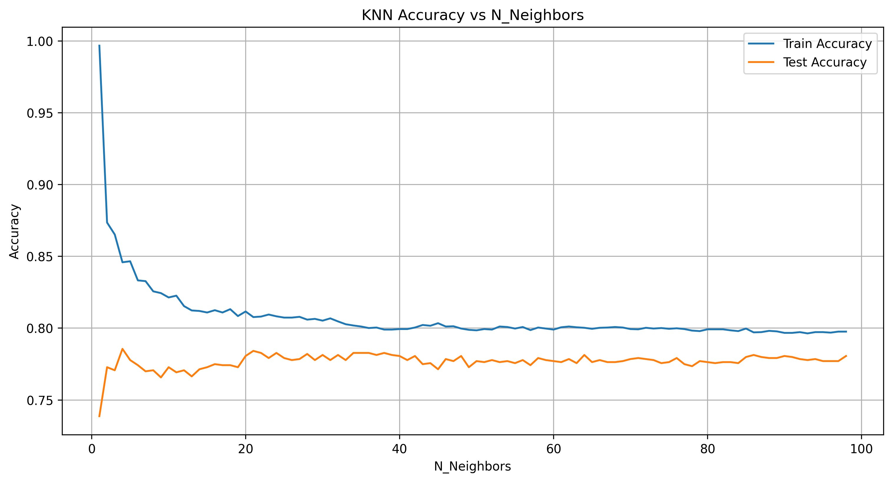
ML Algorithms: K nearest neighbors
The best accuracy with 4 n_neighbors value 78.55 % (before standartization)
and 75.21% (after standardization)
It better then benchmark of 73.9%.

Slide 17
Conclusion:
Decision tree best accuracy Result: 77.84%
Random Forest best accuracy Result: 78.9%
KNN best accuracy Result (before standardization): 78.55%
KNN best accuracy Result (after standardization): 75.21%
The best prediction model is Random Forest 78.9%

Slide 18
Blind dataset

Slide 19
Data Description:
the bda database was created in MongoDB
the created “customers” collection include 25,000 customers , only 23,423 have all fields
in scheme analyze I saw 12 features in the collection
“Services” field had 9 nested fields

Slide 20
Data engineering:
I adjusted the dataset to train dataset in Random Forest model:
3 features was removed: CustomerID, Totalcharges and Paymentmethod
the names of columns was changed and split for 22 columns, that equal to train data frame without “churn” column
the column’s order was adjusted to columns order in train data frame
all data types changed to float64
there are no missing values in the data frame

Slide 21
ML Algorithms: Random Forest
The best model with high accuracy is Random Forest model:
fit model loaded from joblib “random_forest_model.pkl” (3 n_estimators and 7 max_depth)
after prediction was detected 522 potential churn customers
the “churn_pr_predict” column was added to previous dataset that was imported from MongoDB
the “final_churn.csv” file was created

Slide 22
Visualization

Slide 23
Tableau Prep:
connected to “final_churn.csv” created in part b
created Dim_Customers, Dim_Services, Dim_Contract and Fact_Churn hyper files
choose and renamed the columns, created calculated SK column based on CustomerID
Dim_Services – through Pivot Step created new columns ServicesName and ServicesStatus, created ServicesSK based on Orderby () and Rank_Dense() functions
Dim_Contract – columns Tenure, MonthlyCharge and TotalCharges changed type to whole number, PaperlessBilling to Boolean type. The null in TotalCharges is changed ifnull to result of MonthCharge multiply to Tenure.
Fact_Churn joined with all Dim’s table

Slide 24
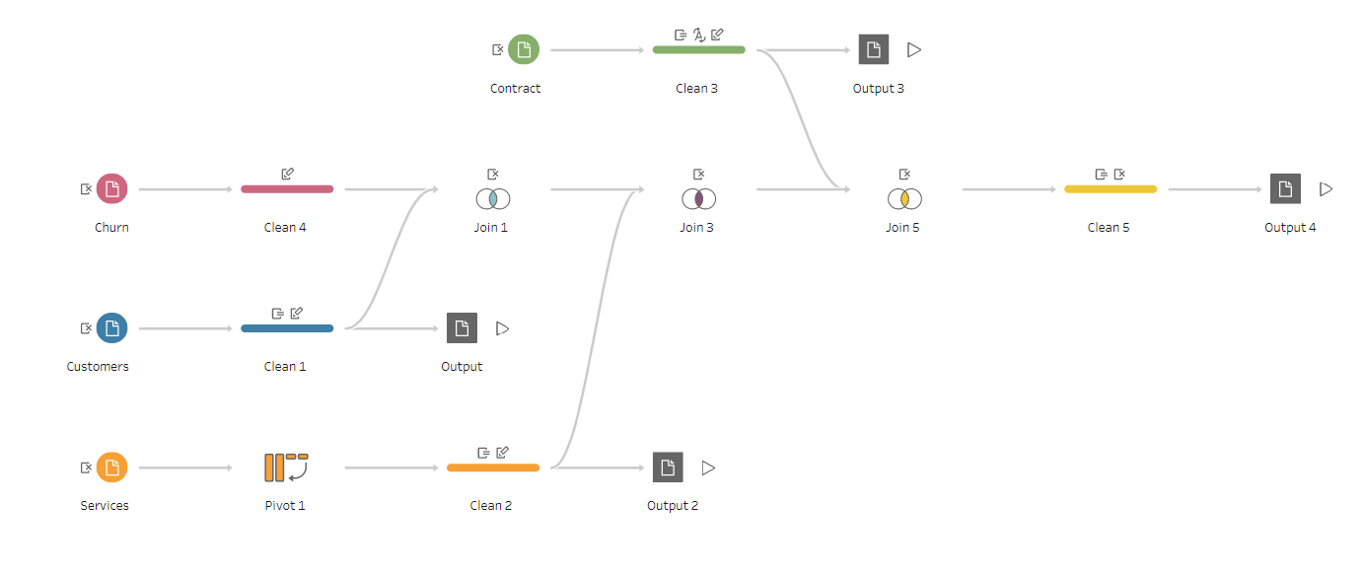
Tableau Prep:
all hyper files saved in Data Source folder
created Flow1 tfl file

Slide 25
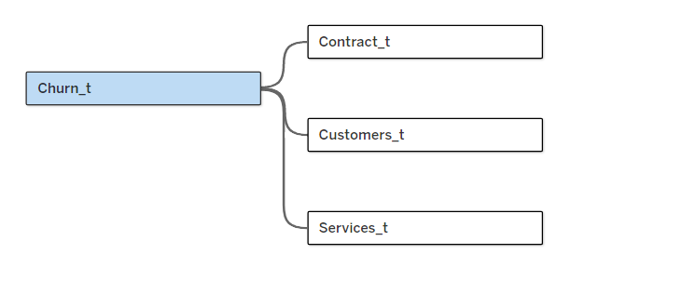
Tableau Desktop:
connected to Dim’s and Fact hyper files
created relationship between tabels
hided unusable columns
saved book1 twb file and created Extract (multiple connection) hyper file

Slide 26
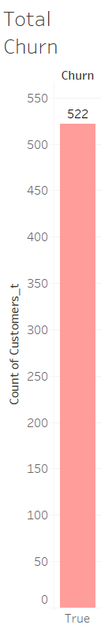
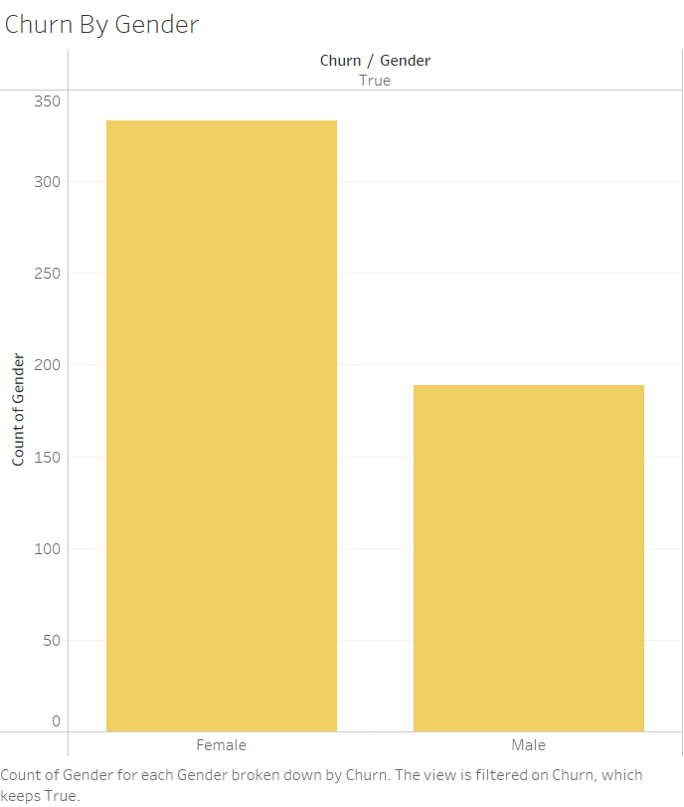
Tableau Desktop:
there are 522 churn clients in the final_churn dataset, 333 female and 189 male.

Slide 27
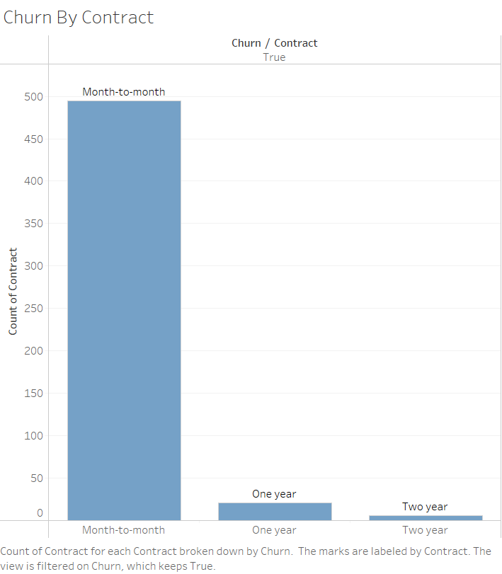
Tableau Desktop:
425 of them churned Month-to-month contract, 21 one year and 6 two year contract

Slide 28
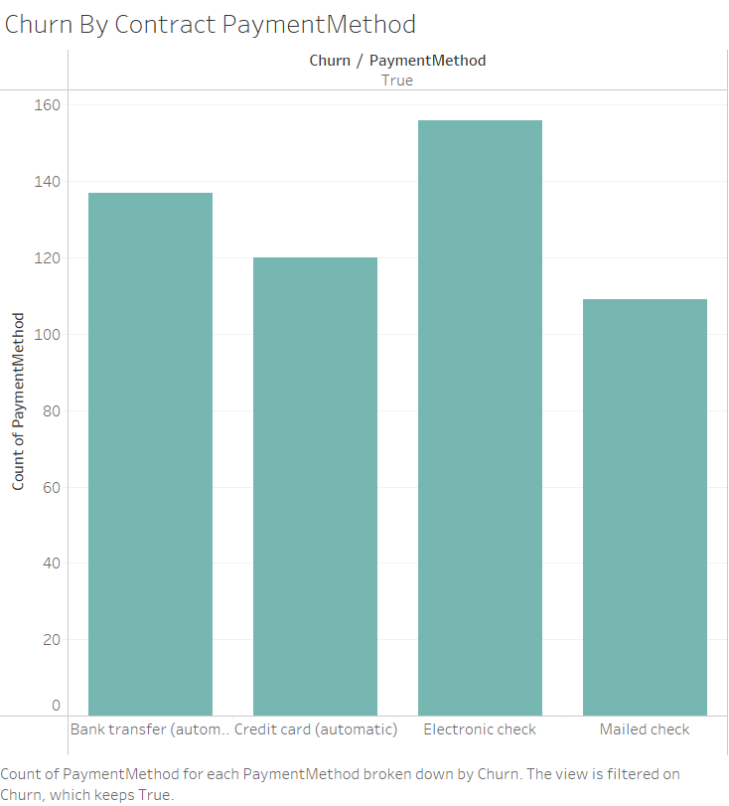
Tableau Desktop:
156 of them had electronic check, 137 bank transfer, 120 credit card, 109 mailed check

Slide 29
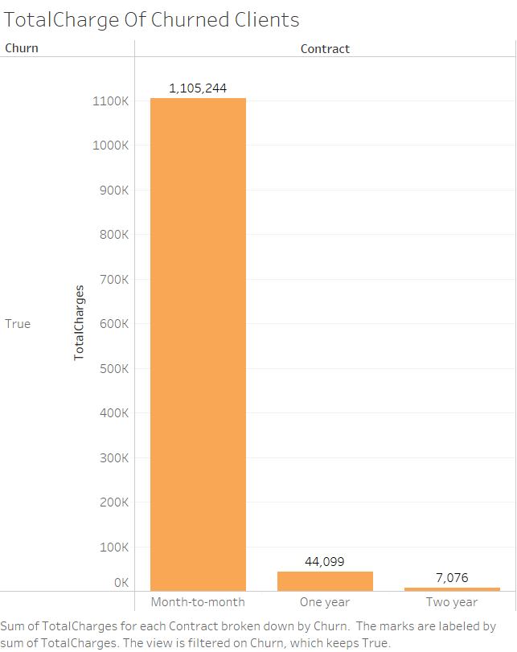
Tableau Desktop:
The value of the company's revenue from abandoned customers according to contracts:
Month-to-month – $1,105,244
One year – $44,099
Two year – $7,076

Slide 30
Conclusion:
According to characteristics that can be identified through the visualizations, it can be said that the predicted data stood out through the same characteristics as the data that we analyzed using Python for the purpose of training and testing the model

